Slide 1
Web-Scale Data Serving with PNUTS
Adam Silberstein
Yahoo! Research

Slide 2
Outline
PNUTS Architecture
Recent Developments
  New features
  New challenges
Adoption at Yahoo!

Slide 3
Yahoo! Cloud Data Systems
CRUD
Point lookups and short scans
Index organized table and random I/Os
Scan oriented workloads
Focus on Sequential disk I/O
Object retrieval and streaming
Scalable file storage

Slide 4
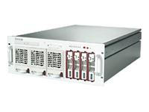

What is PNUTS?
CREATE TABLE Parts (
ID VARCHAR,
StockNumber INT,
Status VARCHAR
…
)
Key1 | 42342 | E
Key2 | 42521 | W
Key3 | 66354 | W
Key4 | 12352 | E
Key5 | 75656 | C
Key6 | 15677 | E
Key1 | 42342 | E
Key2 | 42521 | W
Key3 | 66354 | W
Key4 | 12352 | E
Key5 | 75656 | C
Key6 | 15677 | E
Structured, flexible schema
Key1 | 42342 | E
Key2 | 42521 | W
Key3 | 66354 | W
Key4 | 12352 | E
Key5 | 75656 | C
Key6 | 15677 | E
Parallel database
Geographic replication
Hosted, managed infrastructure

Slide 5
PNUTS Design Features

Slide 6
Distributed Hash Table
Primary Key | Record
Grape | {"liquid" : "wine"}
Lime | {"color" : "green"}
Apple | {"quote" : "Apple a day keeps the …"}
Strawberry | {"spread" : "jam"}
Orange | {"color" : "orange"}
Avocado | {"spread" : "guacamole"}
Lemon | {"expression" : "expensive crap"}
Tomato | {"classification" : "yes… fruit"}
Banana | {"expression" : "goes bananas"}
Kiwi | {"expression" : "New Zealand"}
0x0000
0x2AF3
Tablet
0x911F

Slide 7
Distributed Ordered Table
Primary Key | Record
Apple | {"quote" : "Apple a day keeps the …"}
Avocado | {"spread" : "guacamole"}
Banana | {"expression" : "goes bananas"}
Grape | {"liquid" : "wine"}
Kiwi | {"expression" : "New Zealand"}
Lemon | {"expression" : "expensive crap"}
Lime | {"color" : "green"}
Orange | {"color" : "orange"}
Strawberry | {"spread" : "jam"}
Tomato | {"classification" : "yes… fruit"}
Tablet clustered by key range

Slide 8
PNUTS-Single Region
  Routes client requests to correct storage unit
  Caches the maps from the tablet controller
Maintains map from database.table.key to tablet to storage-unit
  Stores records
  Services get/set/delete requests

Slide 9
Tablet Splitting & Balancing
Each storage unit has many tablets (horizontal partitions of the table)
Storage unit may become a hotspot
Overfull tablets split
Tablets may grow over time
Shed load by moving tablets to other servers

Slide 10
PNUTS Multi-Region

Slide 11
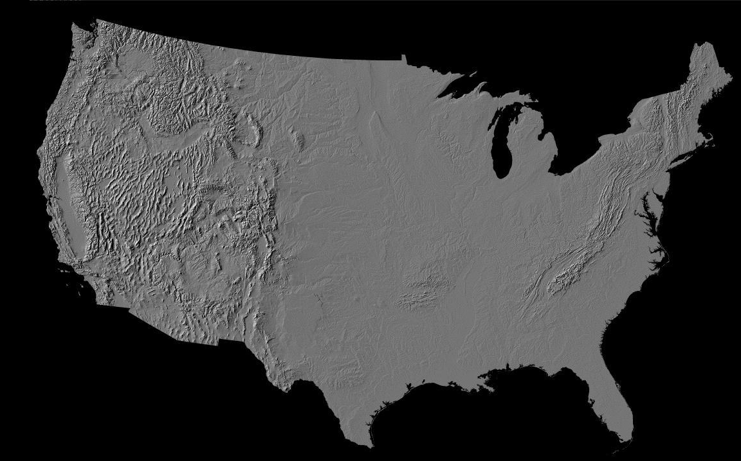
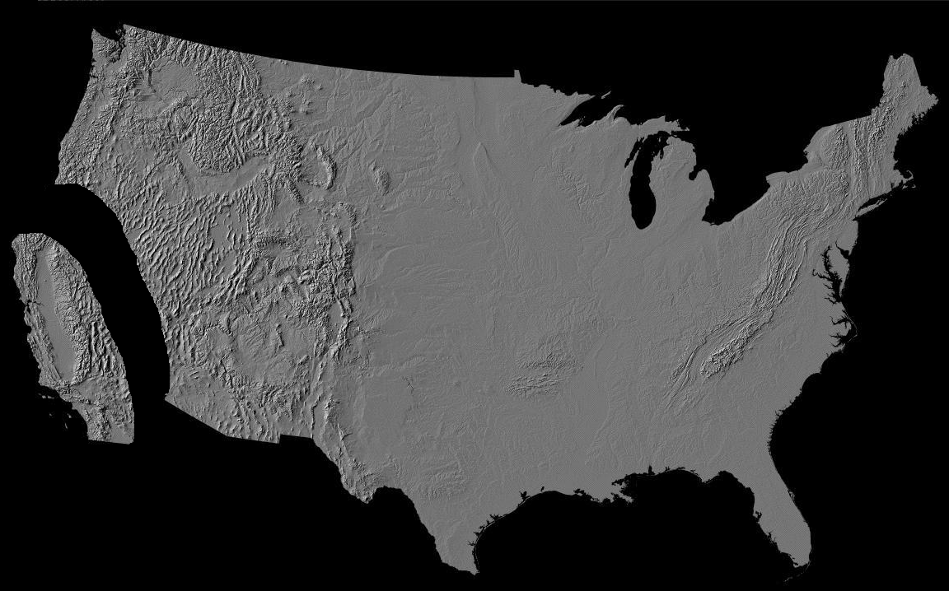


Asynchronous Replication

Slide 12
Consistency Options
Eventual Consistency
  Low latency updates and inserts done locally
Record Timeline Consistency
  Each record is assigned a “master region”
  Inserts succeed, but updates could fail during outages*
Primary Key Constraint + Record Timeline
  Each tablet and record is assigned a “master region”
  Inserts and updates could fail during outages*
Availability Consistency

Slide 13

Record Timeline Consistency
  Transactions:
    Alice changes status from “Sleeping” to “Awake”
    Alice changes location from “Home” to “Work”
(Alice, Home, Sleeping)
(Alice, Home, Awake)
(Alice, Work, Awake)
Region 1
Awake
Work
(Alice, Work, Awake)
Work
(Alice, Home, Sleeping)
(Alice, Work, Awake)
Region 2
No replica should see record as (Alice, Work, Sleeping)

Slide 14
Eventual Consistency
Timeline consistency comes at a price
  Writes not originating in record master region forward to master and have longer latency
  When master region down, record is unavailable for write
We added eventual consistency mode
  On conflict, latest write per field wins
  Target customers
    Those that externally guarantee no conflicts
    Those that understand/can cope

Slide 15
Outline
PNUTS Architecture
Recent Developments
  New features
  New challenges
Adoption at Yahoo!

Slide 16
Ordered Table Challenges
apple
MIN
MIN
carrot
tomato
I
B
banana
avocado
S
L
lemon
MAX
MAX
Carefully choose initial tablet boundaries
  Sample input keys
Same goes for any big load
  Pre-split and move tablets if needed

Slide 17
Ordered Table Challenges
Dealing with skewed workloads
  Tablet split, tablet moves
    Initially operator driven
    Now driven by Yak load balancer
Yak
  Collect storage unit stats
  Issue move, split requests
  Be conservative, make sure loads are here to stay!
    Moves are expensive
    Splits not reversible

Slide 18
Notifications
Many customers want a stream of updates made to their tables
    Update external indexes, e.g., Lucene-style index
    Maintain cache
    Dump as logs into Hadoop
Under the covers, notification stream is actually our pub/sub replication layer, Tribble
client
pnuts
not. client
client index, logs, etc.

Slide 19
Materialized Views
Items
Key | Value
item123 | type=bike, price=100
item456 | type=toaster, price=20
item789 | type=bike, price=200
Async updates via pub/sub layer
Does not efficiently support list all bikes for sale!
Index on type!
Key | Value
bike_item123 | price=100
bike_item789 | price=200
toaster_item456 | price=20
Adding/deleting item triggers add/delete on index
Updating item type trigger delete and add on index
Get bikes for sale with prefix scan: bike*

Slide 20
Bulk Operations
1) User click history logs stored in HDFS
2) Hadoop job builds models of user preferences
3) Hadoop reduce writes models to PNUTS user table
4) Models read from PNUTS help decide users’ frontpage content
HDFS
PNUTS
Candidate content

Slide 21
PNUTS-Hadoop
Reading from PNUTS
Writing to PNUTS
PNUTS
Hadoop Tasks
Hadoop Tasks
PNUTS
Record
Map or Reduce
scan(0x2-0x4)
Map
Reader
scan(0xa-0xc)
set
set
Router
scan(0x8-0xa)
set
set
set
scan(0x0-0x2)
set
set
scan(0xc-0xe)
Split PNUTS table into ranges
Each Hadoop task assigned a range
Task uses PNUTS scan API to retrieve records in range
Task feeds scan results and feeds records to map function
1. Call PNUTS set to write output

Slide 22
Bulk w/Snapshot
Per-tablet snapshot files
Hadoop tasks
PNUTS Storage units
Snapshot daemons
foo
foo
PNUTS tablet map
Send map to tasks
Tasks write output to snapshot files
Sender daemons send snapshots to PNUTS
Receiver daemons load snapshots into PNUTS

Slide 23
Selective Replication
PNUTS replicates at the table-level, potentially among 10+ data centers
  Some records only read in 1 or a few data centers
  Legal reasons prevent us from replicating user data except where created
  Tables are global, records may be local!
    Storing unneeded replicas wastes disk
    Maintaining unneeded replicas wastes network capacity

Slide 24
Selective Replication
Static
  Per-record constraints
  Client sets mandatory, disallowed regions
Dynamic
  Create replicas in regions where record is read
  Evict replicas from regions where record not read
  Lease-based
    When a replica read, guaranteed to survive for a time period
    Eviction lazy; when lease expires, replica deleted on next write
  Maintains minimum replication levels
  Respects explicit constraints

Slide 25
Outline
PNUTS Architecture
Recent Developments
  New features
  New challenges
Adoption at Yahoo!

Slide 26
PNUTS in production
Over 100 Yahoo! applications/platforms on PNUTS
  Movies, Travel, Answers
  Over 450 tables, 50K tablets
Growth, past 18 months
  10s to 1000s of storage servers
  Less than 5 data centers to over 15

Slide 27
Customer Experience
PNUTS is a hosted service
  Customers don’t install
  Customers usually don’t wait for hardware requests
Customer interaction
  Architects and dev mailing list help with design
  Ticketing to get tables
  Latency SLA and REST API
Ticketing ensured PNUTS stays sufficiently provisioned for all customers
  We check on intended use, expected load, etc.

Slide 28
Sandbox
Self-provisioned system for getting test PNUTS tables
Start using REST API in minutes
No SLA
  Just running on a few storage servers, shared among many clients
No replication
  Don’t put production data here!

Slide 29
Thanks!
Adam Silberstein
  silberst@yahoo-inc.com
Further Reading
  System Overview: VLDB 2008
  Pre-planning for big loads: SIGMOD 2008
  Materialized views: SIGMOD 2009
  PNUTS-Hadoop: SIGMOD 2011
  Selective replication: VLDB 2011
  YCSB: https://github.com/brianfrankcooper/YCSB/, SOCC 2010

